Slide 1
Hysacs project
HYPERSPECTRAL IMAGE SEGMENTATION AND ANALYSIS TOWARDS AUTOMATED NON-DESTRUCTIVE MEASUREMENTS OF OLIGOSACCHARIDES AND OTHER TRAITS
Wednesday, July 15, 2020

Slide 2
Contents
Motivation
Data exploring
Segmentation
Dataset
Building AI models
Results

Slide 3
Motivation
Problem Statement:
Screening of large populations(greenhouse and field).
Grain composition relies on labor and cost intensive wet lab analysis.
Solution:
Using light as a non-destructive analytical tool to predict grain composition.
Early determination(before maturity) to save time in greenhouse or on the field.
Approach:
AI-based prediction models based on hyperspectral data from developing region.

Slide 4
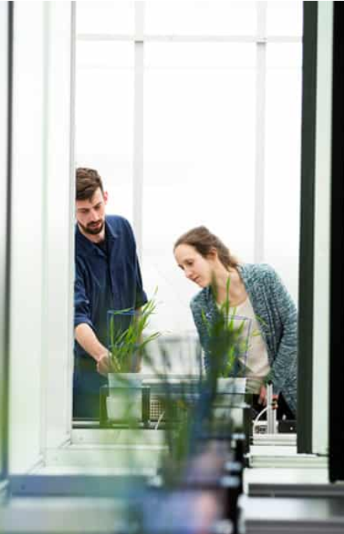
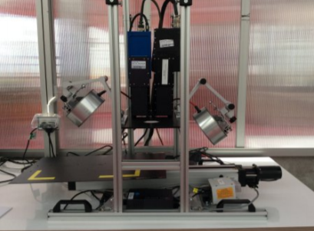
An image of the plants being screened at the hyperspectral plant imaging station at APPF.(right)
Hyperspectral images interrogate the plant physiology at a fine spectral resolution.

Slide 5
Data Exploring
Data collected over the measurement during 2014 and 2015.
2014: 488 recordings VNIR (400-1000 nm) and SWIR (1000-2500 nm)
2015: 399 recordings
2014: ~746 GB compressed spectral data
2015: ~477 GB compressed spectral data
156 genotypes with 3 replicates each
ENVI file format (header file + binary data)
16 bit unsigned integer/ 32 bit float

Slide 6
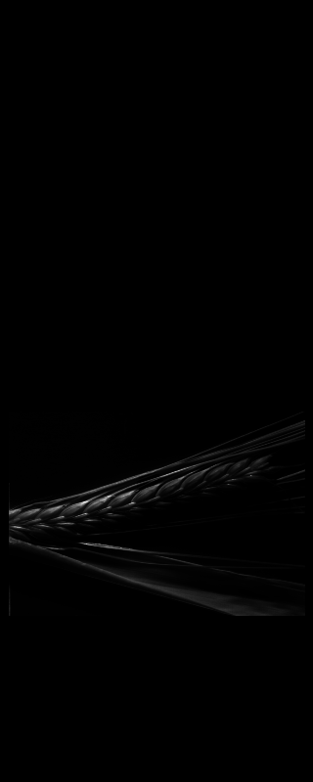
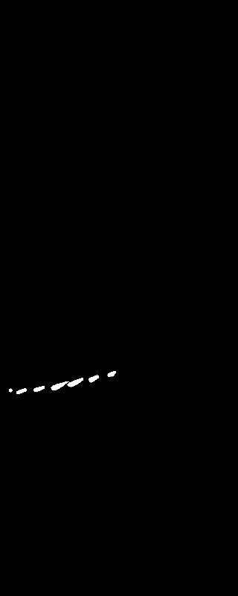
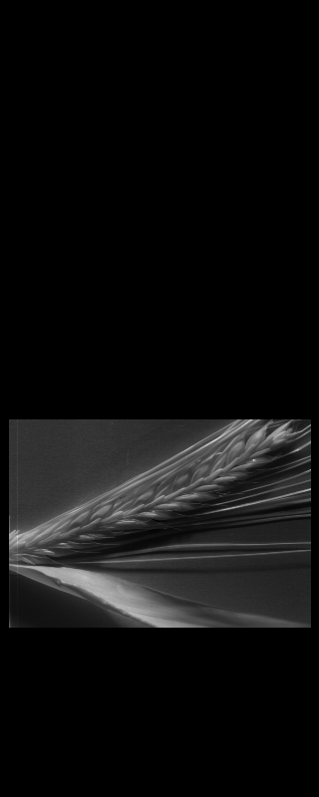
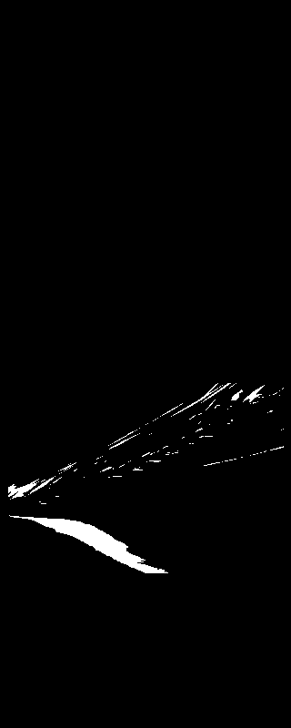
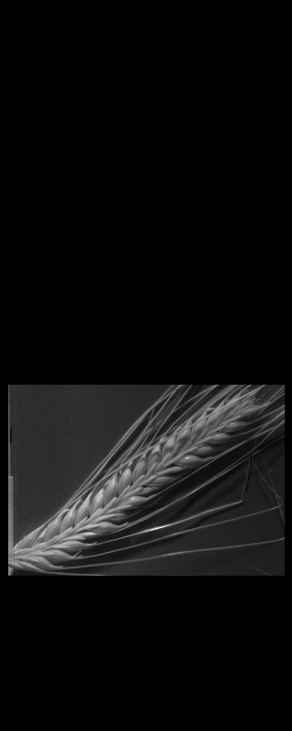
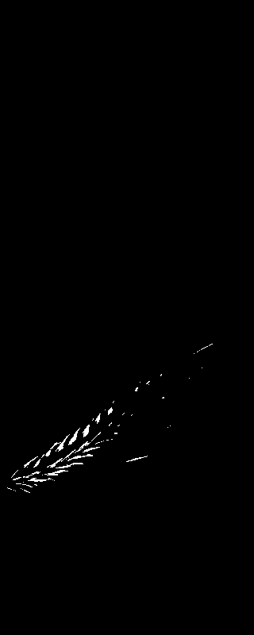
Reading and Visualizing images:
Results based on single channel

Slide 7
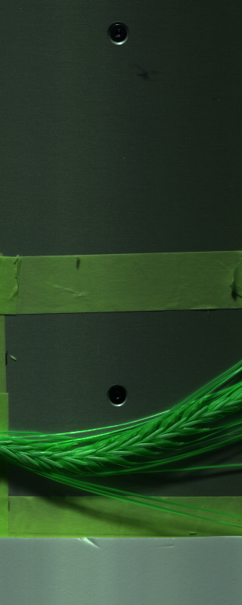
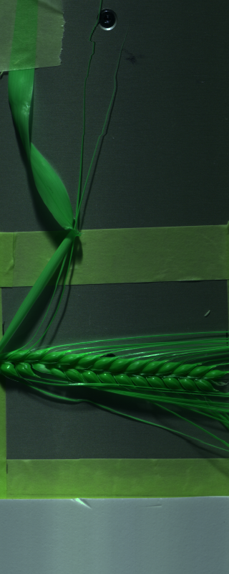
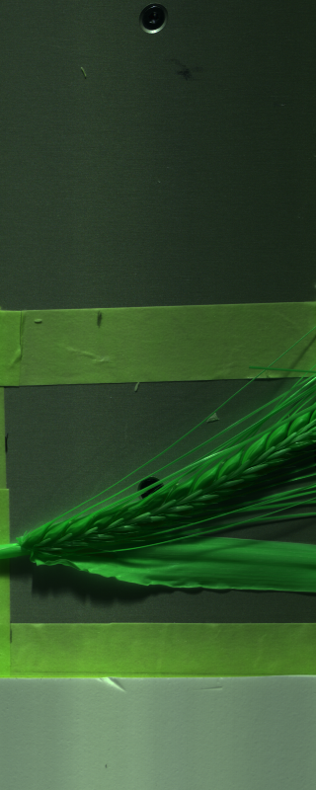
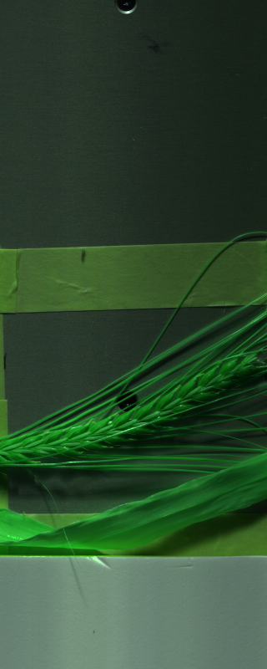
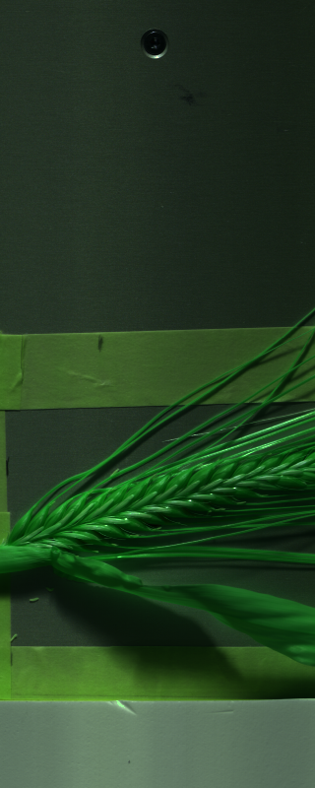
Reading and Visualizing images:
Results based on SWIR recommended channels in header file: 80th, 200th and 48th

Slide 8
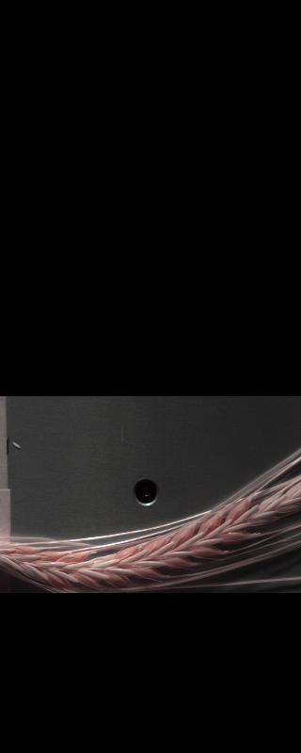
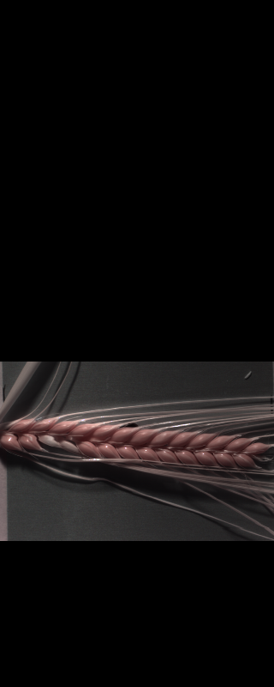
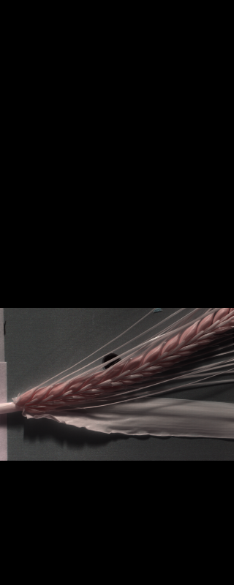
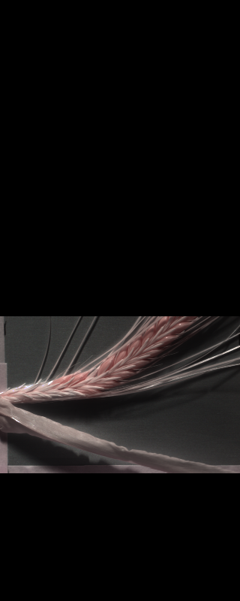
Reading and Visualizing images:
Using three Channels (SWIR)
Only region where spikes located are kept for processing.
Channels used: 55, 41, 12
Still many other combinations possible.

Slide 9

Segmentation Using OpenCV
Changing Color-space
Color Conversion
We use the function cv2.cvtColor(input_image, flag) where flag determines the type of conversion (e. g. cv2.COLOR_BGR2HSV).
Applying mask
We use the function cv2.inRange(HSV_converted_image, lower_bounds, upper_bounds)
For HSV, Hue range is [0,179], Saturation range is [0,255] and Value range is [0,255]. Different softwares use different scales. So need to normalize these ranges.

Slide 10
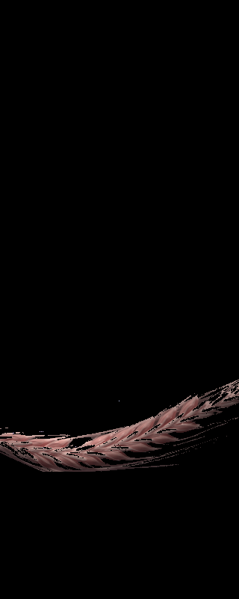
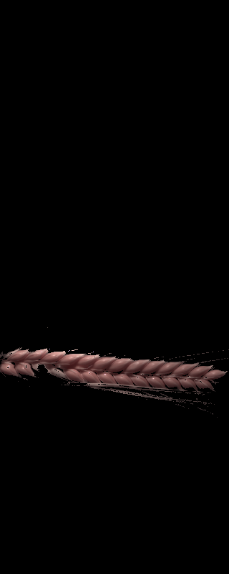
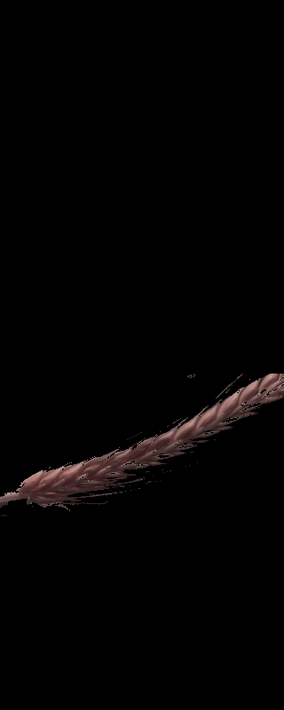
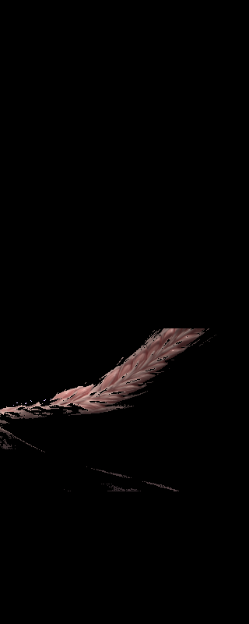
Result of applying Mask
Lower bounds:
(0, 60, 50)
Upper bounds:
(100, 255, 255)
Leaves = removed

Slide 11
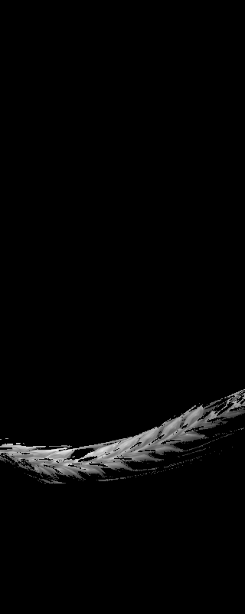
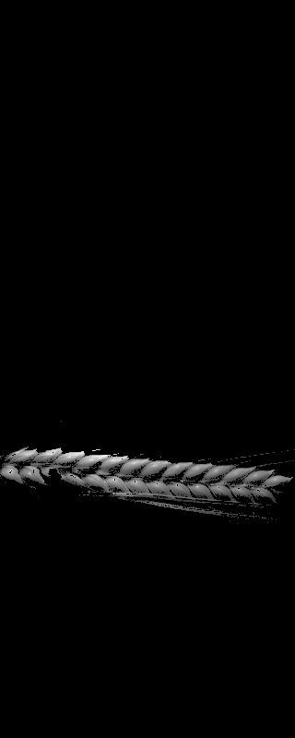
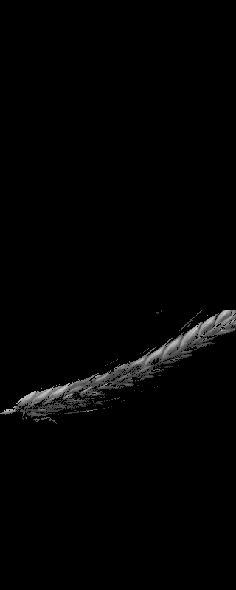
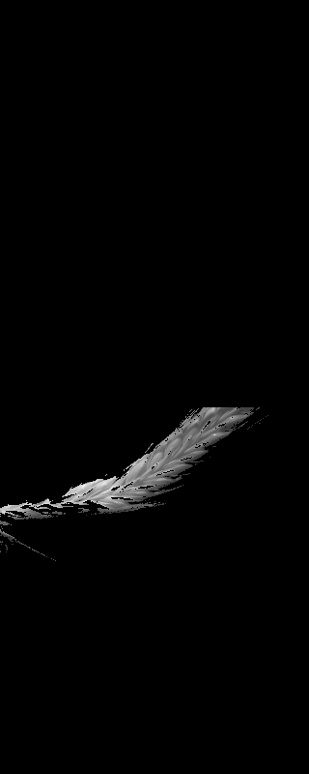
SEGMENTATION - SWIR
Although most of leaves are eliminated, the image still contains some noises around grains.
Our focus was to make the image data cleaner by trying to remove this noise as well.

Slide 12
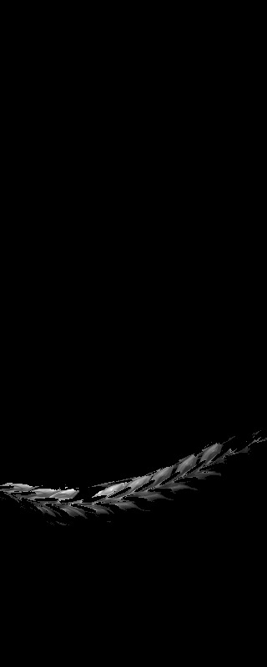
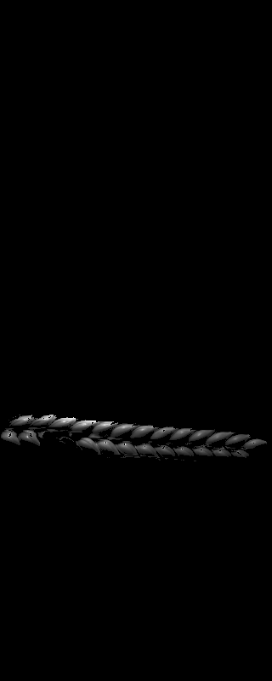
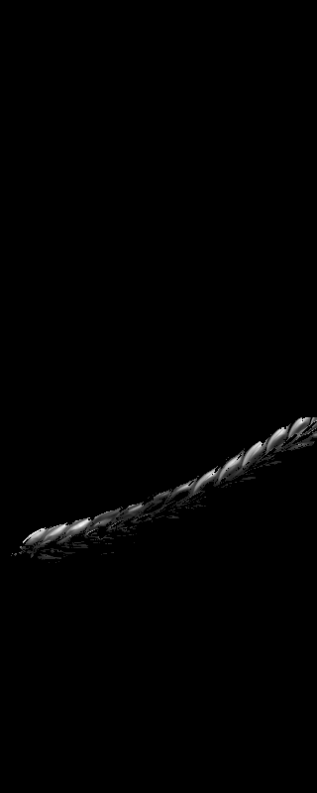

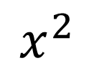
Variable Transformation
Goal:
keep grains well separated
Approach:
Quadratic transformation
pushing back to the range of 0-255
Pros:
can pick a global threshold easier
$$x^{2}$$

Slide 13

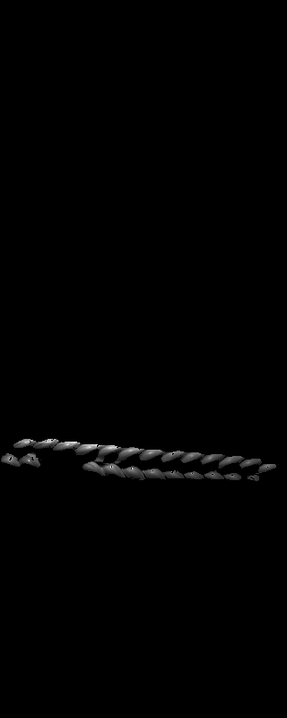
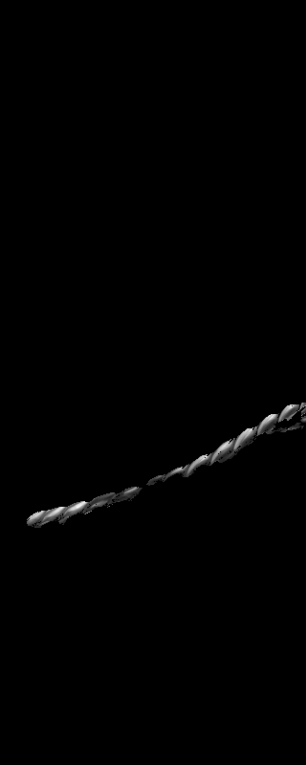
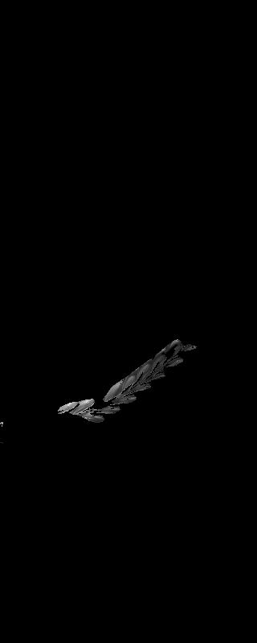

Removing Noises:
Method : Structuring Elements with Radius = 5,
Minimum points = 50
Radius is based on Moore neighborhood
For any pixel, if the number of neighbors being equal or larger than minimum points (50), its kept otherwise its value is changed to zero.

Slide 14
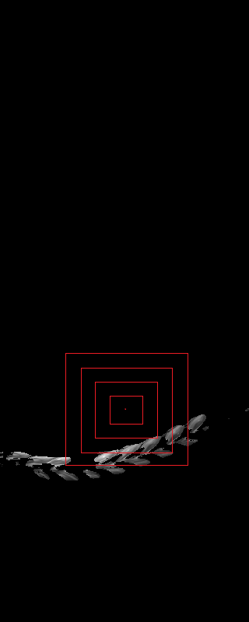
Region OF interest
Now that we have a clean image, we can extract the specific information that we want from it.
Our focus is on the middle grains(5-6).
Starting from middle point of area where spikes are located, we expand its area until we cover 2000 pixels.
This results in a collection of about 4,5 grains within the radius of the center grain from where we started.
Each grain consist of around 20 X 20 pixels.

Slide 15
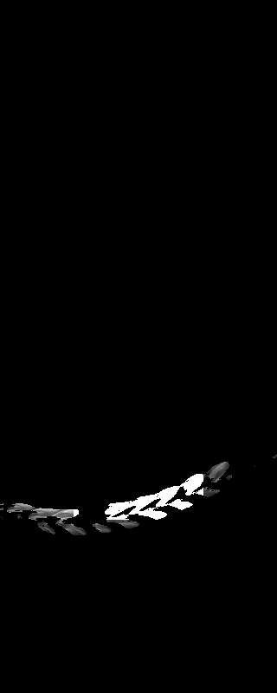
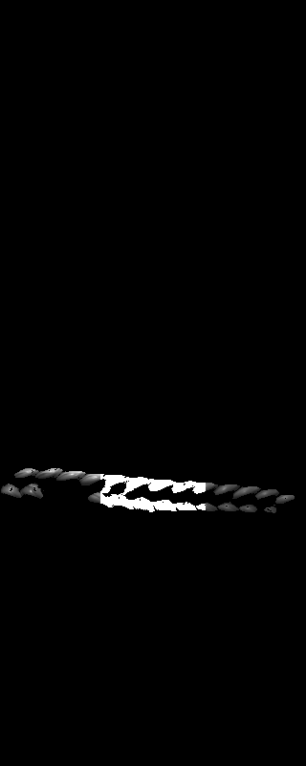
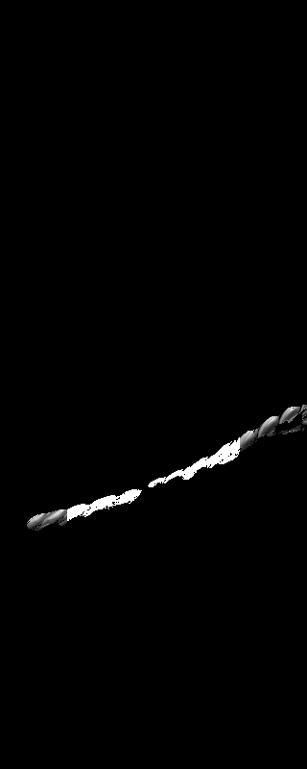
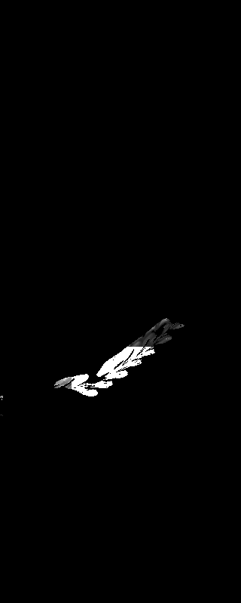
Pick Grains from middle of Spike

Slide 16
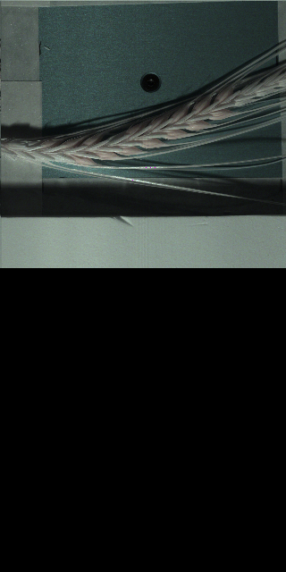
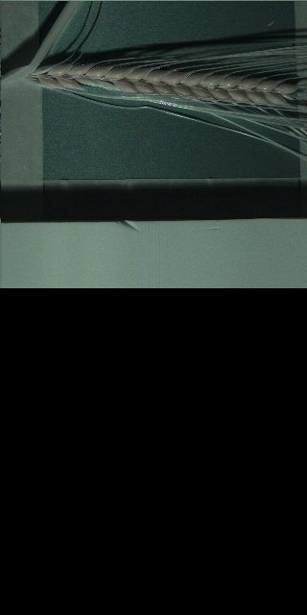
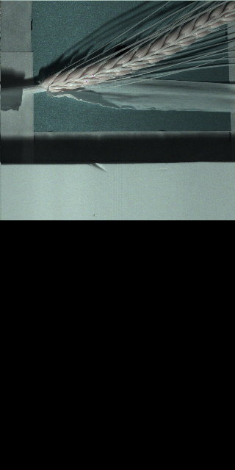
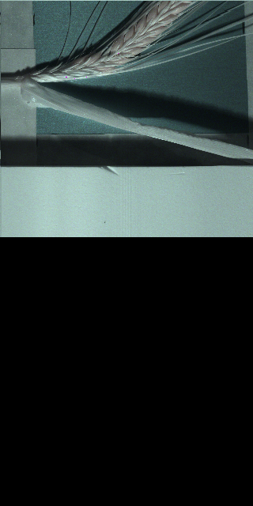
Segmentation - VNIR images
VNIR images have a dimension of 1600 x 3200.
Three channels: 159, 152, 120.
Only area where spikes are located are kept for processing

Slide 17
Resize VNIR
1600 x 3200
320 x 640
Mean
Median
High computation
Take less amount of time
More than 30 min for single image (i5, 8GB ram)
Around 3 min

Slide 18
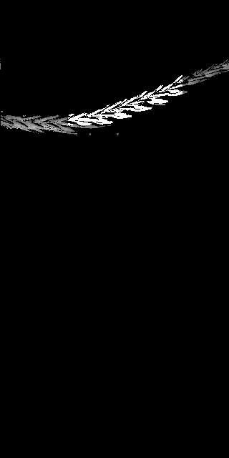
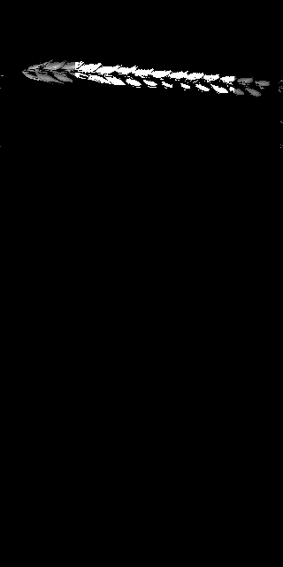
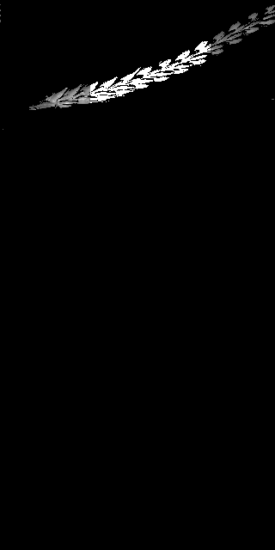

SEGMENTATION – VNIR IMAGES

Slide 19
Segmentation
97% of images are properly segmented
Five Images were damaged
14 images improperly segmented

Slide 20
Segmentation
97% of images are properly segmented
Five Images were damaged
14 images improperly segmented

Slide 21
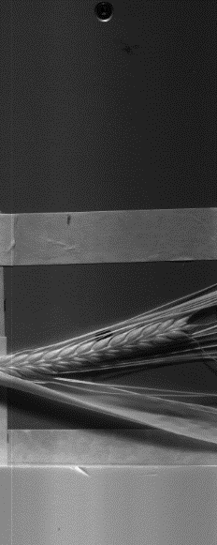

Daylight Intensity
Mean value of yellow highlighted area is taken as reference for daylight intensity value
1
256

Slide 22
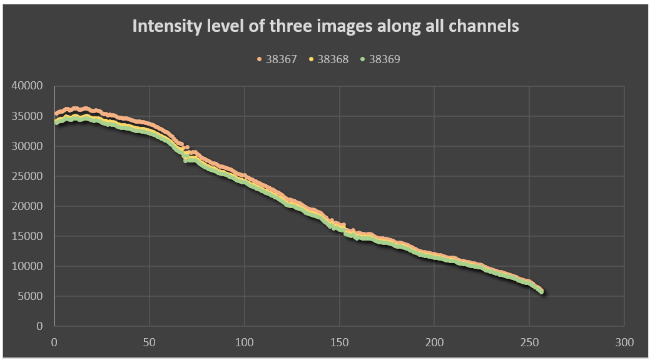
Daylight Intensity
Mean value of each channel is taken as reference for daylight intensity value

Slide 23
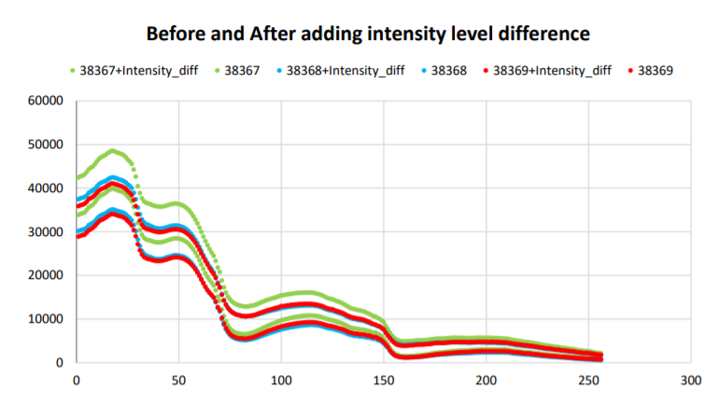
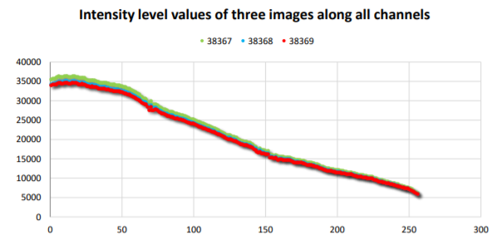
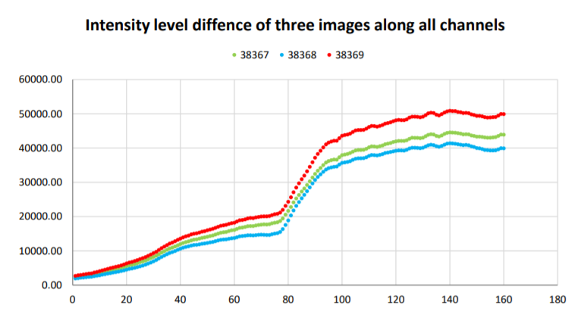
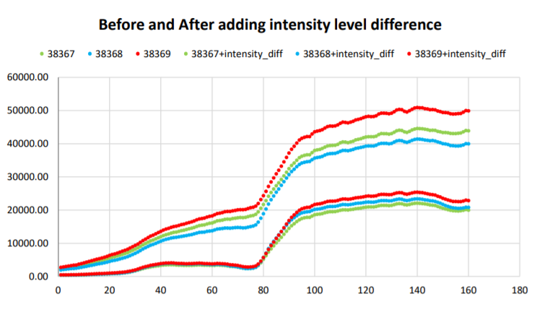
Normalization
Difference of intensity level of each image added on respective image though all channels

Slide 24


Combining images
There is a sharp difference between the channels 160 and 161.
We keep SWIR intact and adjust VNIR to get a smooth curve by matching the values of 160 and 161 channels.

Slide 25


Normalization
Second, we normalized the dataset by dividing the daylight intensity values for each image elementwise across all channels.

Slide 26

Combining Images
Similar to previous approach, the images were combined by keeping SWIR intact and adjusting VNIR values.

Slide 27

Dataset

Slide 28

Dataset

Slide 29
Dataset against Sugar values
Correlation?

Slide 30

Sugar Contents
Mean value of each channel for all the images build our dataset

Slide 31
Models
Split the dataset Based on Genotype

Slide 32
All algorithms tried
Ridge Regression
SVR
Lasso
Elastic Net
Random Forest Regression
Deep Neural Networks
PLS Regression
Stepwise OLS regression

Slide 33
Ridge Regression
Sugar Contents | Mean absolute error | R^2 error | Mean square error
Glucose | 0.511074901 | -3.88061 | 0.442623544
Fructose | 0.626878935 | -3.58233 | 0.658037805
Sucrose | 4.516844231 | -4.40465 | 30.37255988
Raffinose | 2.893977891 | -5.39806 | 13.55439056
Kestose | 1.917278963 | -7.69109 | 5.886601115
Maltose | 0.578016671 | -8.63727 | 0.5331861
Nystose | 1.677731598 | -7.77544 | 4.987306438
Kestopentaose | 0.532623374 | -8.84136 | 0.455078583
Total_Fructan | 8.090380188 | -6.3398 | 111.5696898

Slide 34








Ridge Regression

Slide 35
Elastic Net
Sugar Contents | Mean absolute error | R^2 error | Mean square error
Glucose | 0.225395 | -0.03672 | 0.09402
Fructose | 0.272316 | -0.04594 | 0.150201
Sucrose | 2.072446 | -0.17048 | 6.577736
Raffinose | 1.223988 | -0.10549 | 2.342003
Kestose | 0.667266 | -0.06532 | 0.721554
Maltose | 0.179537 | -0.05939 | 0.058611
Nystose | 0.634522 | -0.17936 | 0.670258
Kestopentaose | 0.160034 | -0.14356 | 0.05288
Total_Fructan | 3.773329 | -0.58032 | 24.02191

Slide 36
Elastic Net

Slide 37
Lasso
Sugar Contents | Mean absolute error | R^2 error | Mean square error
Glucose | 0.22319 | -0.05337 | 0.09553
Fructose | 0.264749 | -0.05339 | 0.15127
Sucrose | 2.049952 | -0.15177 | 6.472586
Raffinose | 1.161771 | -0.00836 | 2.136232
Kestose | 0.662869 | -0.04797 | 0.709804
Maltose | 0.17603 | -0.04968 | 0.058074
Nystose | 0.612399 | -0.05749 | 0.600999
Kestopentaose | 0.158774 | -0.09359 | 0.050569
Total_Fructan | 3.405795 | -0.30661 | 19.86133

Slide 38








Lasso

Slide 39
R^2 error

Slide 40
Mean absolute error

Slide 41
Mean square error

Slide 42
Models
Based on Randomly splitting dataset into train and test (taking means of 10 replicates)

Slide 43
Ridge Regression
Sugar Contents | Mean absolute error | R^2 error | Mean square error
Glucose | 0.441288 | -3.0415 | 0.324161
Fructose | 0.579718 | -3.48335 | 0.562616
Sucrose | 3.550131 | -2.64905 | 20.32791
Raffinose | 2.058246 | -2.58193 | 6.888539
Kestose | 1.366227 | -2.94252 | 2.942811
Maltose | 0.392421 | -2.48984 | 0.25688
Nystose | 1.366642 | -2.97526 | 2.933128
Kestopentaose | 0.391586 | -3.02246 | 0.249752
Total_Fructan | 6.465502 | -2.93823 | 67.35755

Slide 44








Ridge Regression

Slide 45
Elastic Net
Sugar Contents | Mean absolute error | R^2 error | Mean square error
Glucose | 0.221439 | 0.056633 | 0.083809
Fructose | 0.277698 | 0.04544 | 0.141775
Sucrose | 1.960413 | -0.08924 | 6.061645
Raffinose | 1.106896 | -0.01355 | 1.974434
Kestose | 0.668826 | 0.007923 | 0.783563
Maltose | 0.185754 | 0.132907 | 0.064505
Nystose | 0.706149 | 0.02043 | 0.789722
Kestopentaose | 0.196809 | 0.025075 | 0.073493
Total_Fructan | 3.525995 | -0.14442 | 21.76777

Slide 46








Elastic Net

Slide 47
Lasso
Sugar Contents | Mean absolute error | R^2 error | Mean square error
Glucose | 0.220978 | -0.01924 | 0.080412
Fructose | 0.269796 | -0.01317 | 0.126867
Sucrose | 1.882335 | 0.014208 | 5.482845
Raffinose | 1.104471 | 0.026226 | 1.918576
Kestose | 0.652554 | 0.025089 | 0.73997
Maltose | 0.187364 | 0.119368 | 0.070103
Nystose | 0.678549 | 0.017393 | 0.732928
Kestopentaose | 0.183541 | -0.00063 | 0.058472
Total_Fructan | 3.137438 | -0.01234 | 17.19574

Slide 48








Lasso

Slide 49
R^2 error

Slide 50
Mean absolute error

Slide 51
Mean square error

Slide 52
Removing noisy images
Taking Sucrose in to consideration
Relative Error > 0.4
List of 28 images having relative error larger than 0.4
38371 | 38571 | 38629 | 38805
38390 | 38583 | 38699 | 38806
38405 | 38588 | 38727 | 38824
38473 | 38589 | 38728 | 38828
38475 | 38608 | 38750 | 38858
38530 | 38622 | 38791 | 38861
38568 | 38627 | 38793 | 38865

Slide 53
Removing noisy images

Slide 54
Elastic net

Slide 55
Summary
The segmentation that was performed on the data given was satisfactory(97% of the images were properly segmented).
We tried various normalization techniques and performed experiments on numerous regression models.
No single regression model gave us the intended results.
Example , Elastic Net performed good for Maltose, although not as expected.

Slide 56
THANK YOU!

